Slide 1
CSCE 436 – Advanced Embedded Systems Lecture 27 – Digital Low Pass Filter
Prof Jeffrey Falkinburg Avery Hall 368 472-5120

Slide 2
Lesson Outline
Time Logs!
Project Proposals Due Today
Digital Low Pass Filter
Filtering
Low Pass Filter
Filter Design Problems

Slide 3
Filtering

Slide 4
Filtering
Problem with sampling analog signal at discrete times?
Aliasing problems with frequency folding

Slide 5
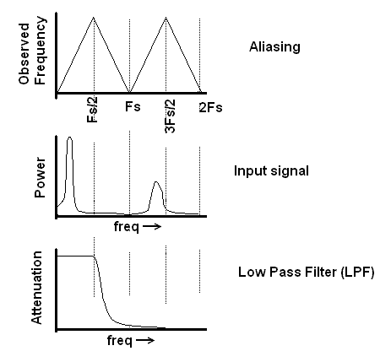
Filtering
Frequency Folding creates problems in sampled systems like an ADC because noise anywhere in the spectrum will fold back into our sampling region as shown below
Notes:
Observed frequency chart shows amplitude vs frequency.

Slide 6
Filtering
In order to address this problem we will utilize a principle called attenuation.
Attenuation - process of changing the amplitude of a waveform without changing its frequency.
Amount of attenuation is quantified in terms of decibels.
dB = 20 * log (V_out/V_in)
V_out/Vin | dB
1 | 0
1/10 | -20
1/100 | -40
1/1000 | -60
1/256 | -48.1648
1/1024 | -60.206
1/1.41254 | -3dB
1/2512 | -68dB
0.1V
48KHz

Slide 7
Filtering Questions

Slide 8
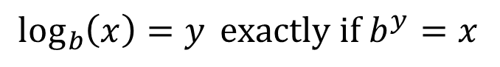
Filtering Questions
Question 1: If you input a 1v sin wave into a circuit that attenuated it by -40dB, what would the amplitude of the output waveform be?
Given: dB = 20 * log (V_out/V_in)
-40db = 20 log (V_out/1V_in)
-2 = log (V_out/1V_in)
V_out = 10⁻²
V_out = 0.01
V_out = 10mV
$$\log_{b}\left(x\right)=y exactly if b^{y}=x$$

Slide 9
Filtering Questions
Question 2: If you input a 1v sin wave into a circuit that attenuated it by -68dB, what would the amplitude of the output waveform be?
Given: dB = 20 * log (V_out/V_in)
-68db = 20 log (V_out/1V_in)
-3.4 = log (V_out/1V_in)
V_out = 10^{-3.4}
V_out = 0.4mV

Slide 10
Filtering Questions
Question 3: If you reduced a signal by a factor of 1/256, how many dB would you need to attenuate it by?
Given: dB = 20 * log (V_out/V_in)
dB = 20 log (1/256)
dB = -48dB

Slide 11
Low Pass Filter

Slide 12
Low Pass Filter
We will use a circuit called a low pass filter to attenuate signals.
You can build an analog low pass filter by putting a resistor and capacitor in parallel.

Slide 13
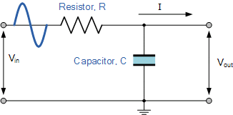
Low Pass Filter
Low Pass Filter
Vin
Vout
Passive Low Pass Filter:
https://www.electronics-tutorials.ws/filter/filter_2.html

Slide 14
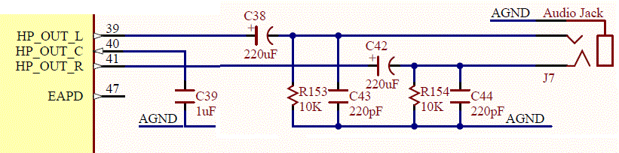
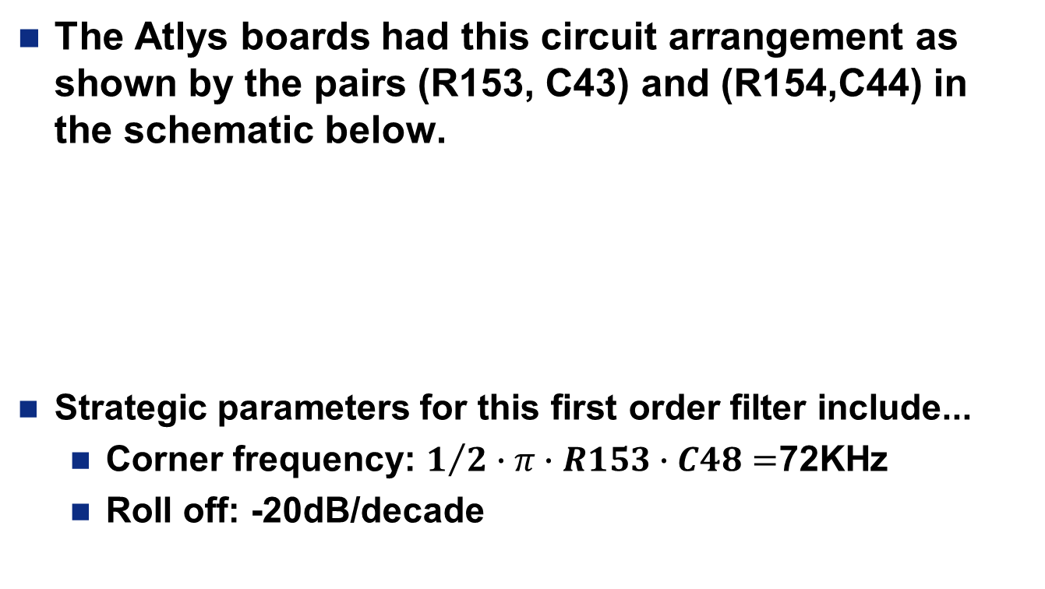
Low Pass Filter
The Atlys boards had this circuit arrangement as shown by the pairs (R153, C43) and (R154,C44) in the schematic below.
Strategic parameters for this first order filter include...
Corner frequency: $1/2∙π∙R153∙C48=$72KHz
Roll off: -20dB/decade

Slide 15
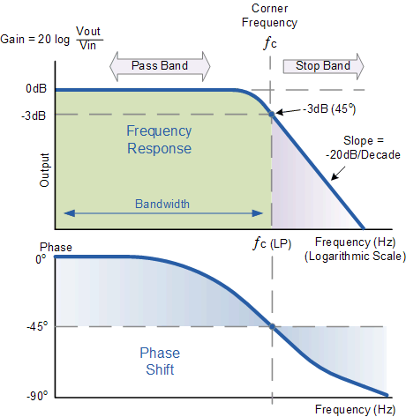
Low Pass Filter
For a Low Pass filter, the attenuation applied to an input signal depends on the input frequency.
Relationship is characterized in the filters frequency response graph. http://www.electronics-tutorials.ws/filter/fil10.gif

Slide 16
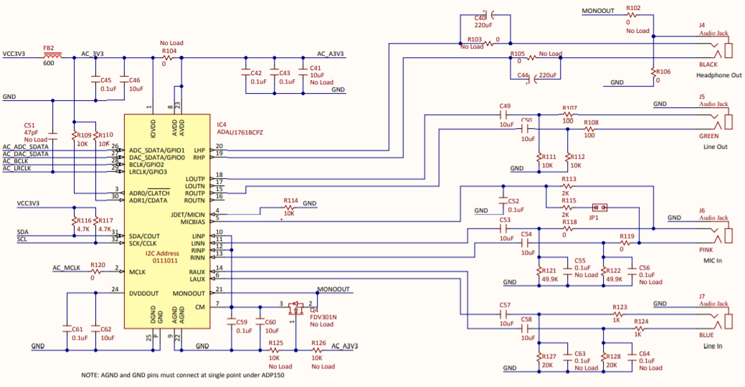
Nexyx Video Audio Codec Schematic

Slide 17
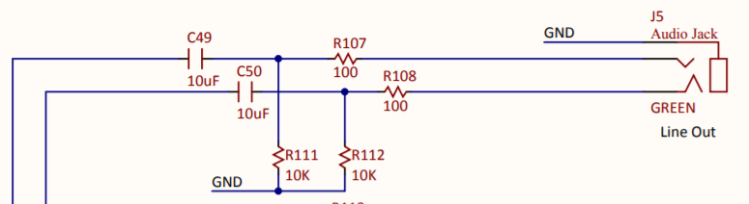
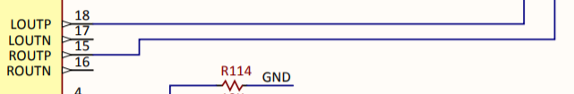
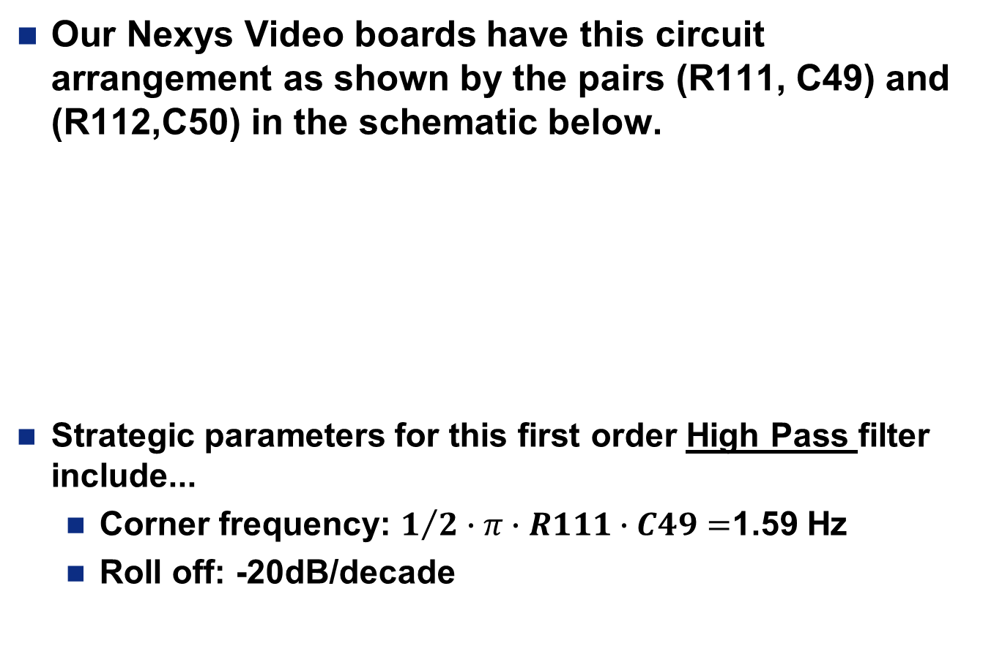
High Pass Filter
Our Nexys Video boards have this circuit arrangement as shown by the pairs (R111, C49) and (R112,C50) in the schematic below.
Strategic parameters for this first order High Pass filter include...
Corner frequency: $1/2∙π∙R111∙C49=$1.59 Hz
Roll off: -20dB/decade

Slide 18
Filter Design Problems

Slide 19
Filter Design Problem
Lets test out understanding of all these concepts with a filter design problem.
1. Aliasing:
Your sampling an analog signal at 48KHz. List all the frequencies that will look like 2KHz signals.
1st harmonic: 2KHz
48KHz-2KHz = 46KHz
2nd harmonic: 48KHz+2KHz=50KHz
96KHz-2KHz = 94KHz
3rd harmonic: 96KHz+2KHz=98KHz 144KHz-2KHz = 142KHz

Slide 20
Filter Design Problem
2. Decades:
A first-order LPF has a cutoff frequency of 2KHz. Describe the attenuation of a 80KHz input signal in decibels and as a ratio of output voltage to input voltage.
Since a decade is a multiplicative factor of 10, we need to find how may powers of 10 you have to multiply by in order to increase 2 to 80. In order words
2*10^x = 80, solving for X yields
x = log_10(80/2) = 1.6 Decades

Slide 21
Filter Design Problem
2. Decades:
1 KHz → 10 KHz ➔ 1 Decades
10 KHz → 100 KHz ➔ 1 Decades
1 KHz → 100 KHz ➔ 2 Decades
1 KHz → 48 KHz ➔ 1.7 Decades

Slide 22
Filter Design Problem
2. Decades Cont:
So we know that a 80KHz waveform is 1.6 decades above a 2KHz waveform. Since the LPF attenuates -20db/decade, the 80Kkz waveform will be attenuated 1.6*-20 = -32db
Decibels can be converted to the ratio of output/input using its definition...
-32db = 20db log_10(V_out/V_in)
V_out/Vin = 0.025 = 1/40

Slide 23
Filter Design Problem
3. ADC convert:
You are working with a 10-bit ADC and would like to attenuate some frequency below 1/2 ULP. How many dB will be required to achieve this?
A 10-bit ADC has a range of [0-1023], so half the unit of least place will be 1 part in 2048
In terms of decibels this is
20*log_10(1/2^11) = -66dB
ADC convert Cont:
What if we change it to 1 ULP?
20*log(2⁻¹⁰)= 60dB

Slide 24
Filter Design Problem
4. Sampling frequency:
Given:
Signal of interest is 0-2KHz
2nd order filter
10-bit ADC
What is the minimum sampling rate at 1 ULP?
Reduce first fold-back to -60bB so that its at most 1ULP. Since the corner frequency is set to 2KHz, first fold-back to 2KHz must be reduced by -57dB.
At -40dB/decade this is 1.425 decades above 2KHz
Fs-2KHz = 2KHz*10^1.425 = 53KHz.
Thus, the minimum sampling frequency Fs=55KHz.

Slide 25
Filter Design Problem
4. Sampling frequency:
Given:
Signal of interest is 0-2KHz
2nd order filter
10-bit ADC
What is the minimum sampling rate at 0.5 ULP?
Reduce first fold-back to -66bB so that its at most 1/2ULP. Since the corner frequency is set to 2KHz, first fold-back to 2KHz must be reduced by -63dB.
At -40dB/decade this is 1.58 decades above 2KHz
Fs-2KHz = 2KHz*10^1.58 = 76KHz.
Thus, the minimum sampling frequency is 78KHz.

Slide 26
Filter Design Problem
5. Sampling frequency:
Given:
Signal of interest is 0-2KHz
1st order filter
8-bit ADC
What is the sampling rate?
The underlying goal here is to reduce any noise folded back into our signal band below 1 ULP in the ADC.
Since we are using an 8-bit ADC, we want to reduce the noise to 1/256 (i.e. 1/2^8) of the signal.
This works out to -48dB (i.e. 20*log_10(2^-8))

Slide 27
Filter Design Problem
5. Sampling frequency Cont:
If we sample the signal at F_s, then the region between [F_s-2k, F_s] will get folded back into our signal band.
Consequently, the filter must be between 2k and F_s-2k to attenuate the signal.
Since we have a first order filter, we will get -20dB of attenuation for every decade.
Since we need -48dB, we will need 2.4 decades, or a factor of 251 over 2k or 502KHz.
F_s - 2K = 2K * 10^2.4 = 502.38KHz
Thus we have F_s - 2k = 502k or F_s = 504KHz.
Notes:
2.4 decades → (-20dB/decade = -48 dB/x decades)
factor of 251 → (10^2.4 = 251)
F_s - 2K = 2K * 10^2.4 = 502.38KHz

Slide 28
Filter Design Problem
6. Sampling frequency:
Given:
Signal of interest is 0-2KHz
1st order filter
10-bit ADC
What is the minimum sampling rate at 1/2ULP?
Reduce first fold-back to -66bB so that its at most 1/2ULP. Since the corner frequency is set to 2Kh, first fold-back to 2KHz must be reduced -63dB. At -20dB/decade this is 3.15 decades above 2KHz or 2KHz*10^3.15 = 2.8Mhz
Thus, the minimum sampling frequency is Fs = 2.8Mhz + 2KHz = 2.8Mhz
Wow, what a difference that extra order in the filter made!

Slide 29
Filter Design Problem
7. Filter specs:
Given:
Signal of interest is 0-2KHz
8-bit ADC
Maximum possible sampling rate of 80KHz
What order filter do we need?
An 8-bit ADC required -48db of attenuation to get the noise below 1ulp (unit of least place). From 2KHz to 78KHz is 1.6 decades (solve 2K*10^x = 78K)
The roll off of an x-order LPF is -20*x db/decade.
-20*x db -48 db
------------ = --------------- ➔ x = 1.5, so 2nd order filter is needed.
decade 1.6 decade

Slide 30
Filter Design Problem
8. Signal bandwidth:
Given:
16-bit ADC
4th order filter
Sampling frequency 250KHz
What is the maximum frequency of the signal of interest?
A 16-bit ADC required -96db of attenuation to get the noise below 1ulp.
Let the sampling frequency be called F_{alpha}.
Fold back will occur at 250k - F_{alpha}.

Slide 31
Filter Design Problem

Slide 32
Filter Design Problem
8. Signal bandwidth Cont:
Filter must attenuate signal over:
F_{alpha}*10^x = 250k - F_{alpha}
log((250k - F_{alpha}) / F_{alpha}) decades
4th order filter rolls off at -80db/decade
-80 db -96 db
-------- = ------------------------------
decade log((250k - F_{alpha})/F_{alpha}) decade
F_{alpha}= 14.8KHz

